Slide 1
Constraints on massive vector dark energy models from ISW-galaxy cross-correlations
Shintaro Nakamura (Tokyo University of Science)
In collaboration with A. De Felice (YITP), R. Kase (TUS), and S. Tsujikawa (TUS)
Based on arXiv: 1811.07541

Slide 2
Integrated Sachs-Wolfe (ISW) effect
Constant potential
(e.g., matter dominant)
Potential decays
(e.g., ΛCDM model)
Potential grows
(e.g., cubic Galileon)
Detection of late-time ISW effect in a flat universe is
independent evidence for dark energy.
Taking the cross-correlation between the CMB anisotropy and
the galaxy distributions, we can separate the ISW signal from
the CMB anisotropy.
The gravitational potential is actually constant
in a matter dominated universe on large scales.

Slide 3
Dark energy model with
The cross-correlation between ISW effect in CMB and galaxy distributions
is given by
CMB temperature anisotropy
Galaxy number density fluctuations
This cross-correlation can distinguish the different dark energy models:
GR
・ΛCDM model
The ISW-galaxy cross-correlation is positive.
spin0
・Cubic-order scalar-tensor theories
(e.g.) Galileon gravity, kinetic gravity braiding Horndeski theories
We place observational constraints on the dark energy model
in generalized Proca theories by using the cross-correlation data of the ISW effect and galaxy distributions.
The ISW-galaxy cross-correlation can be negative.
spin1
・Cubic-order vector-tensor theories
positive or negative?
(e.g.) Generalized Proca theories

Slide 4
Example: Kinetic Gravity Braiding (scalar-tensor theories)
with
R. Kimura, T. Kobayashi and K. Yamamoto (2012)
where
: scalar field
The data of ISW-galaxy
cross-correlation constrain
the power in range
Cubic Galileon
is excluded.

Slide 5
Generalized Proca theories: a vector field coupled to gravity
G. Tasinato (2014),
L. Heisenberg (2014),
J. B. Jimenez and L. Heisenberg (2016)
Generalized Proca (GP) theories are the U(1)-broken vector-tensor theories
with second-order equations of motion.
A massive vector field can be the source of dark energy.
GP theories up to cubic-order are given by the following action,
In the scalar limit , GP theories
reduce to the shift-symmetric Horndeski theories.
DOFs: 2 tensors + 2 vectors + 1 scalar
gravitational
waves
(transverse)
(longitudinal)
: the matter action

Slide 6
Concrete dark energy models
・ The flat FLRW background:
・ The components of a vector field with the scalar perturbations:
・ The concrete models
: constants.
The cubic vector Galileon corresponds to the case with .
When , there are the solutions characterized by
with
grows with the decrease of to give rise to
the late-time cosmic acceleration.

Slide 7
Dark energy equation of state in GP theories
Radiation era：
Matter era：
de Sitter era：
: Deviation from ΛCDM model
: Radiation density parameter
: DE density parameter
The solutions converge to
a de Sitter attractor.
The combined analysis of SNIa,
CMB, BAO, and RSD showed that
Smaller
Vector Galileon
( )
A. De Felice, L. Heisenberg and S. Tsujikawa (2017)

Slide 8
Evolution of matter density perturbations
We introduce gauge-invariant gravitational potentials:
In Fourier space with the comoving wave number ,
these potential are related with the matter density contrast , as
Newtonian potential:
Weak lensing potential:
The density contrast obeys
In GR,

Slide 9
Evolution of matter density perturbations
We introduce gauge-invariant gravitational potentials:
In Fourier space with the comoving wave number ,
these potential are related with the matter density contrast , as
Newtonian potential:
Weak lensing potential:
The density contrast obeys
In GR,
In cubic-order GP theories, generally,
As long as the ghost and gradient instabilities are absent ( ),

Slide 10
Cross-correlation amplitude
Under the small angle approximation, the cross-correlation amplitude
is given by
: window function
: bias
: growth factor
: the matter power
spectrum
This quantity determines the sign of the cross-correlation power spectrum.

Slide 11
Gravitational coupling related to light bending
In our models,
where is associated with the intrinsic vector mode such that
: coefficient of kinetic term
of vector perturbation
(in our model )
In the limit ,
the evolution of perturbation is similar to that in GR.
In the limit ,
this model reduces to a subclass of scalar-tensor theories.

Slide 12
ISW-galaxy cross-correlations in concrete models
The cross-correlation data: Giannantonio et al (2016)
SN, A. De Felice, R. Kase and S. Tsujikawa (2018)
Cross-correlation function
today
Smaller
Smaller
The intrinsic vector mode can give rise to positive cross-correlations
compatible with the data.

Slide 13
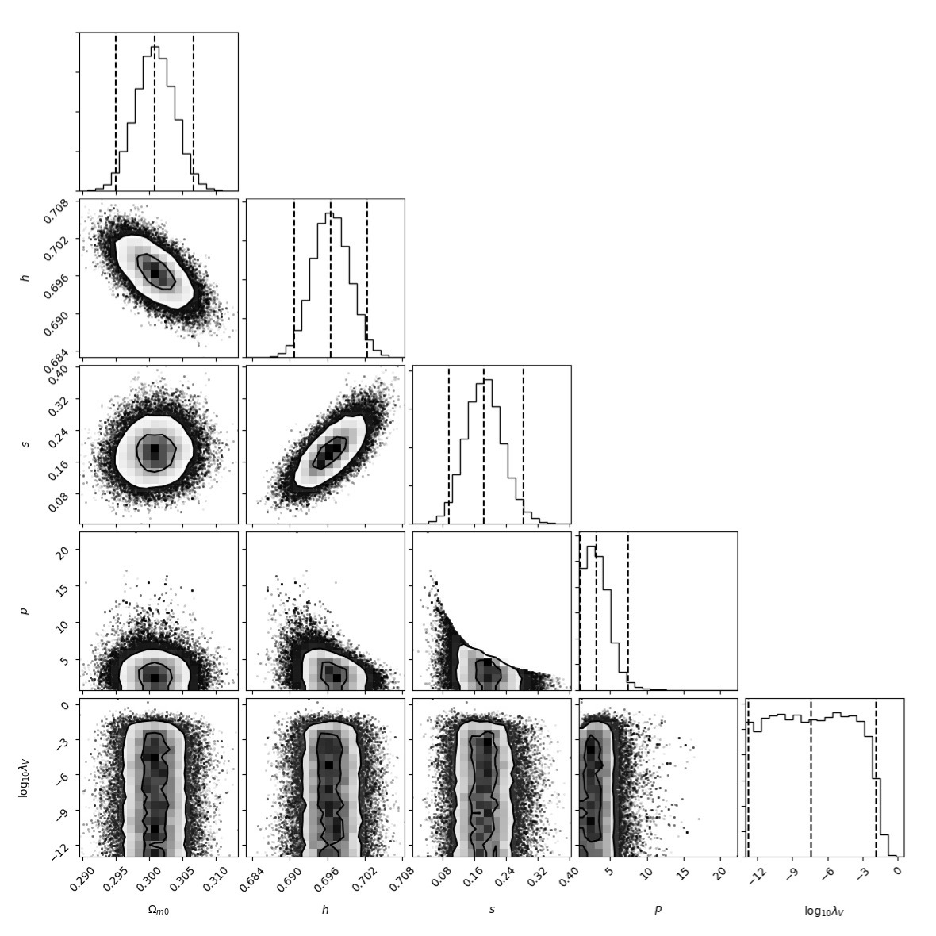
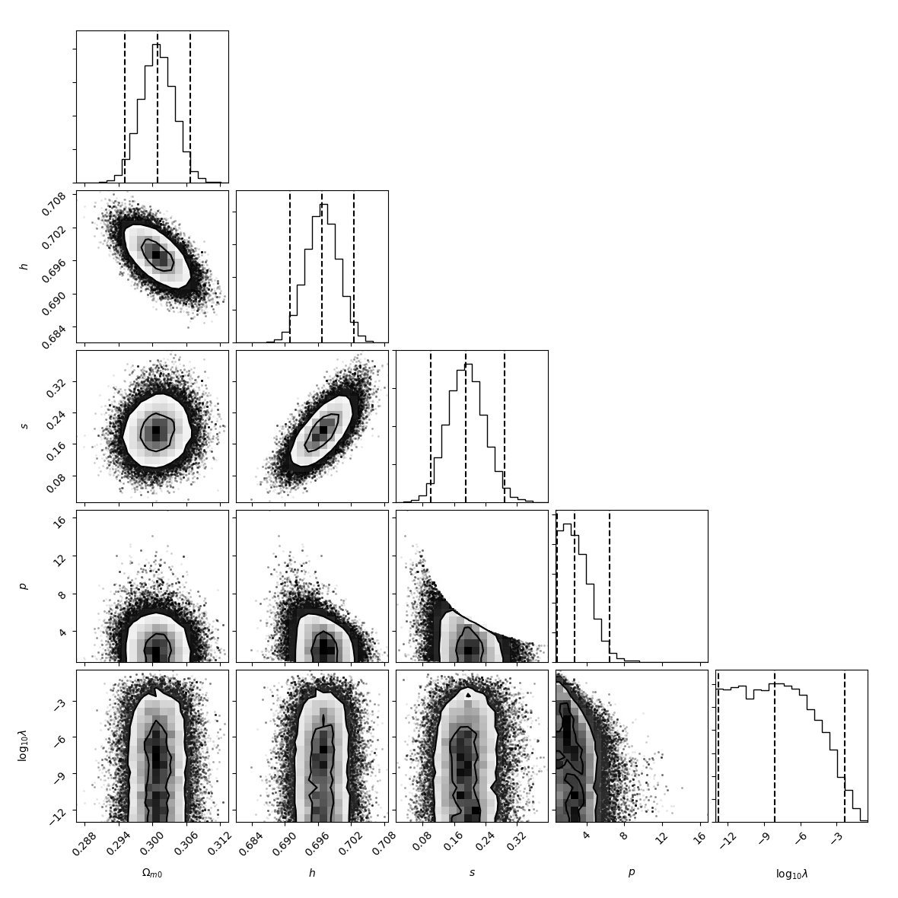
Observational constraints
The additional prior
to avoid strong coupling
problem in early epoch:
SN, A. De Felice, R. Kase and S. Tsujikawa (2018)
We use the data of CMB, BAO, SN Ia, the Hubble expansion rate,
RSD, and the ISW-galaxy cross-correlations with the catalogues
of 2MASS and SDSS.
Deviation from
ΛCDM model
The model with still fits the data better than the ΛCDM model.
Best-fit:
ΛCDM:

Slide 14
Best-fit case in massive vector dark energy model
The background dynamics in our model is different from that in ΛCDM,
while the perturbation dynamics is almost the same as that in ΛCDM.
Cross-correlation function

Slide 15
Summary
・ We studied observational constraints on a dark energy model
in cubic-order generalized Proca theories by using the data of
CMB, BAO, SN Ia, RSD and ISW-galaxy cross-correlation.
・ Due to the existence of intrinsic vector mode, the ISW-galaxy
cross-correlation can be positive even for cubic interactions
unlike that in scalar-tensor theories.
・ The model with still fits the data better than the ΛCDM model
even by including the ISW-galaxy cross-correlation data.
・ It remains to be seen whether future high-precision observations show
some evidence that the dark energy model in the vector-tensor theories
is favored over the ΛCDM model.

Slide 16
Integrated Sachs-Wolfe (ISW) effect
The ISW effect in the CMB anisotropy is given by
: gauge-invariant
gravitational potentials
Constant potential
(e.g., matter dominant)
Potential decays
(e.g., ΛCDM model)
Detection of late-time ISW effect
in a flat universe is independent
evidence for dark energy.
Potential grows
(e.g., cubic Galileon)
Taking the cross-correlation between the CMB anisotropy and
the galaxy distributions, we can separate the ISW signal from
the CMB anisotropy.
The gravitational potential is actually constant
in a matter dominated universe on large scales.

Slide 17
Appendix

Slide 18
Mass scale of a massive vector field
the mass scale m is of the order of the today’s Hubble constant .

Slide 19
Generalized Proca theories
G. Tasinato (2014),
L. Heisenberg (2014),
J. B. Jimenez and L. Heisenberg (2016)
The EOMs are second-order on general space-time with 5 DOFs.
Intrinsic
vector mode
where
：Levi-Civita tensor
・DOFs: 2 tensors + 2 vectors + 1 scalar
・In the scalar-limit ( ), reduces to the shift-symmetric Horndeski theories.

Slide 20
Equations of motion
・ The flat FLRW background:
・ The components of a vector field with the scalar perturbations:

Slide 21
Comparison

Slide 22
Local measurement of the Hubble expansion rate
From the observations of Cepheids in galaxies of SN Ia
can be constrainted from the measurement of the folloing ratio
in BAO measurements:
Then, the statics is given by

